Slide 1
Tiny Tapeout Project
AXI Stream to UART Communication System
Presented by,
TEAM 1

Slide 2
INTRODUCTION
The AXI Stream to UART system transfers parallel data from an AXI-Stream interface to a UART serial channel.
Data send by the AXI-Stream master is pushed into a synchronous FIFO buffer. The FIFO output is then serialized and transmitted by the UART transmitter.
On the receiver side, the UART receiver deserializes the data, checks parity, and outputs parallel data.

Slide 3
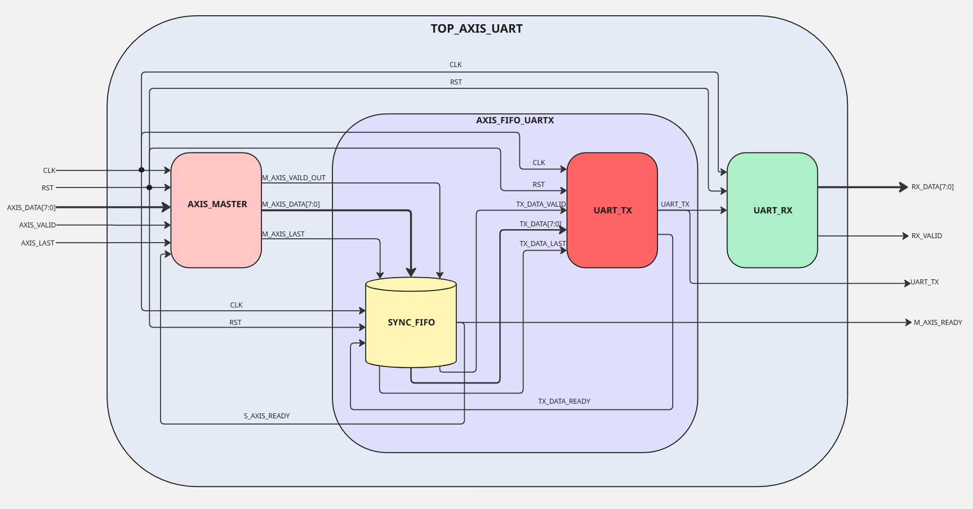
BLOCK DIAGRAM

Slide 4
SIGNALS
Pin Name | Direction | Width | Function
clk | Input | 1 | Clock Signal
rst | Input | 1 | Active High Synchronous Reset
axis_data | Input | 8 | Parallel input data from AXI Stream master
axis_valid | Input | 1 | AXI Stream valid signal – indicates valid data for axis_data
axis_last | Input | 1 | Indicates last data in a frame
m_axis_ready | Output | 1 | Indicates that system is ready to accept new AXI data i.e. the FIFO is not full.
uart_tx | Output | 1 | UART serial transmit line
rx_valid | Output | 1 | High for one clock cycle when new data is received successfully
rx_data | Output | 8 | Parallel data after UART reception

Slide 5
DESIGN PARAMETERS
Parameter | Value
Data Bits | 8 bits per UART frame
Baud Rate | 115200
Clock Frequency | 50 Mhz
FIFO Depth | 8 bytes

Slide 6
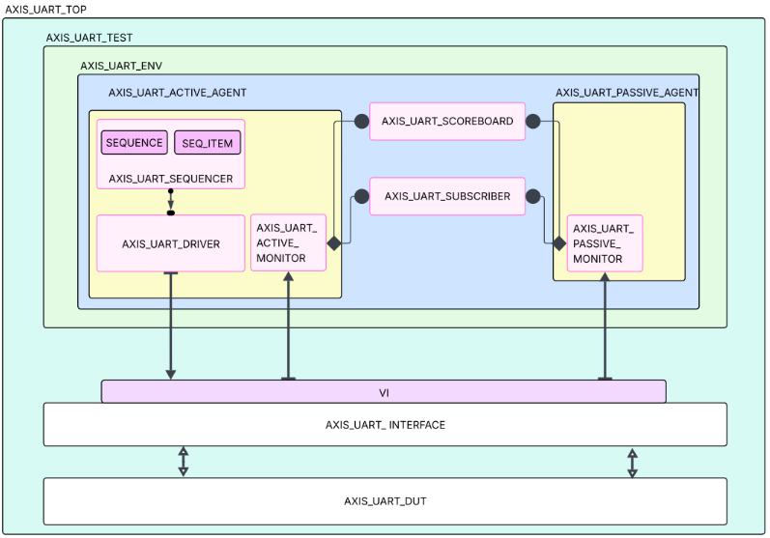
TESTBENCH ARCHITECTURE

Slide 7
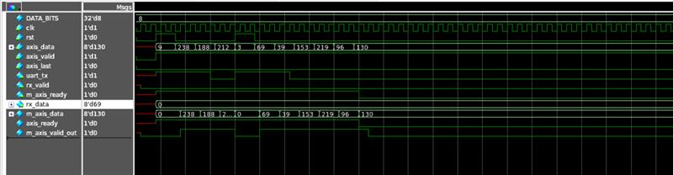
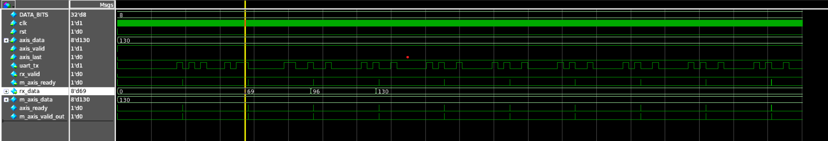
ERRORS IN DUT
  Reset condition – BUG1
    While asserting the reset high after few clock cycles, the last 2 bytes of data were only coming and all other data were lost.
    When reset given in the initial clock cycles the DUT was working fine but giving in between caused unexpected behaviour.

Slide 8
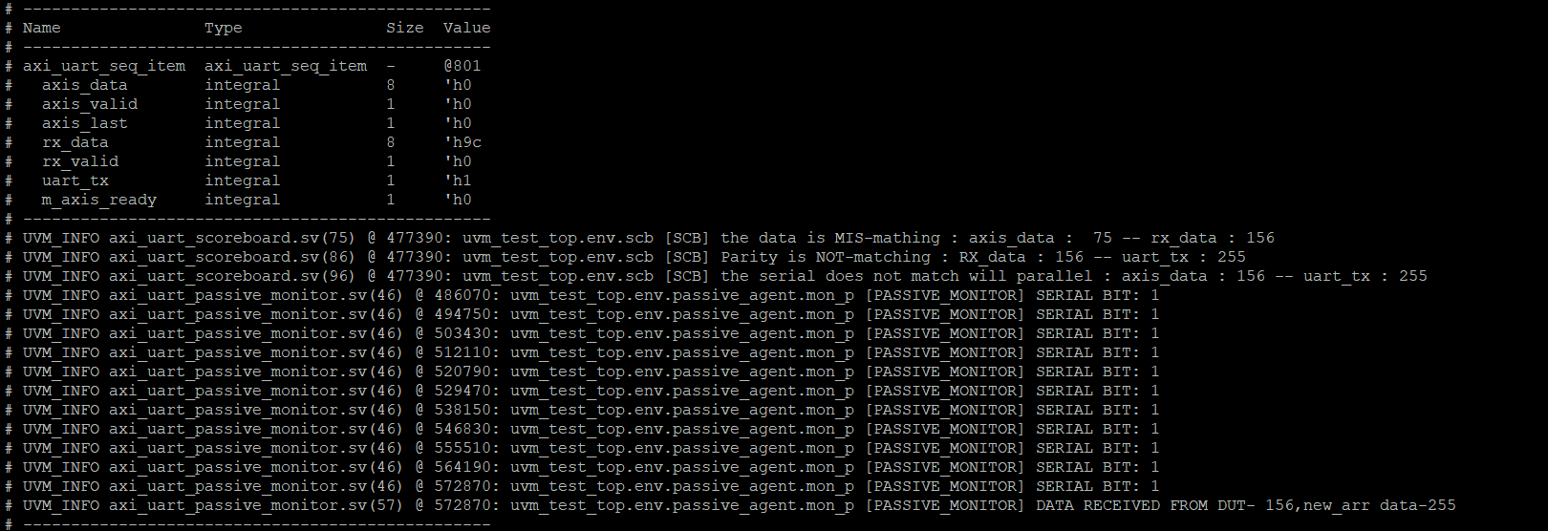
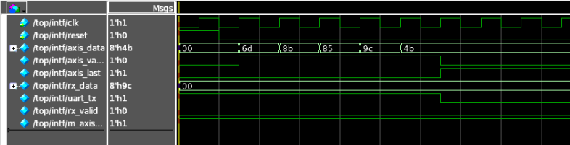
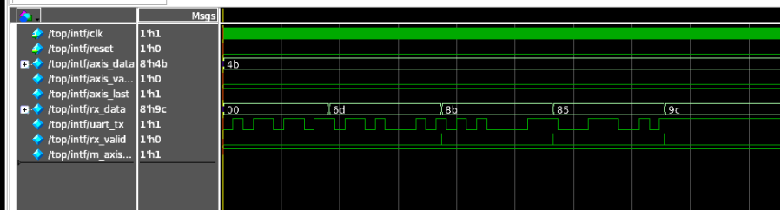
  Sending Stream of Data – BUG2
    While sending the stream of data the last byte of data was always erased.

Slide 9
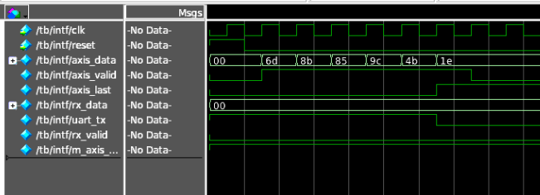
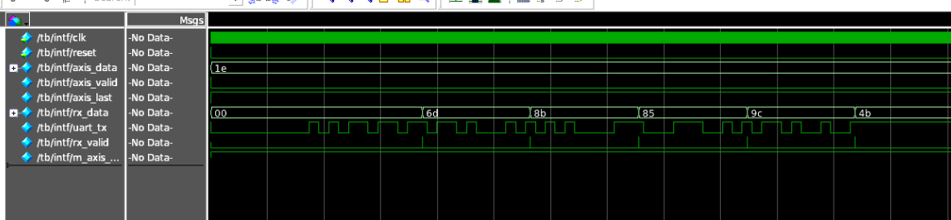
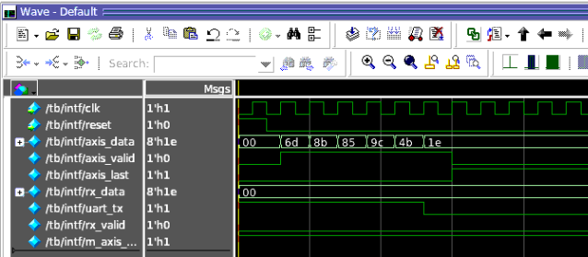
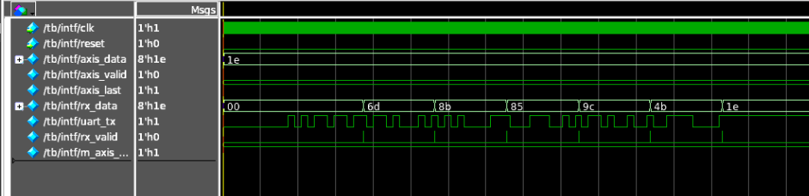
  Axis_last behaviour – BUG3 (Specification Bug)
    According to the initial specification the axis_last signal should be triggered with the last byte of data, indicating the DUT that no more data will be sent.
    While asserting the axis_last with the last byte of data ,was making us loose the last byte.
    This was reported and the specification was changed mentioning that the asxis_last should be asserted 1 clock cycle after the last byte of data only.

Slide 10
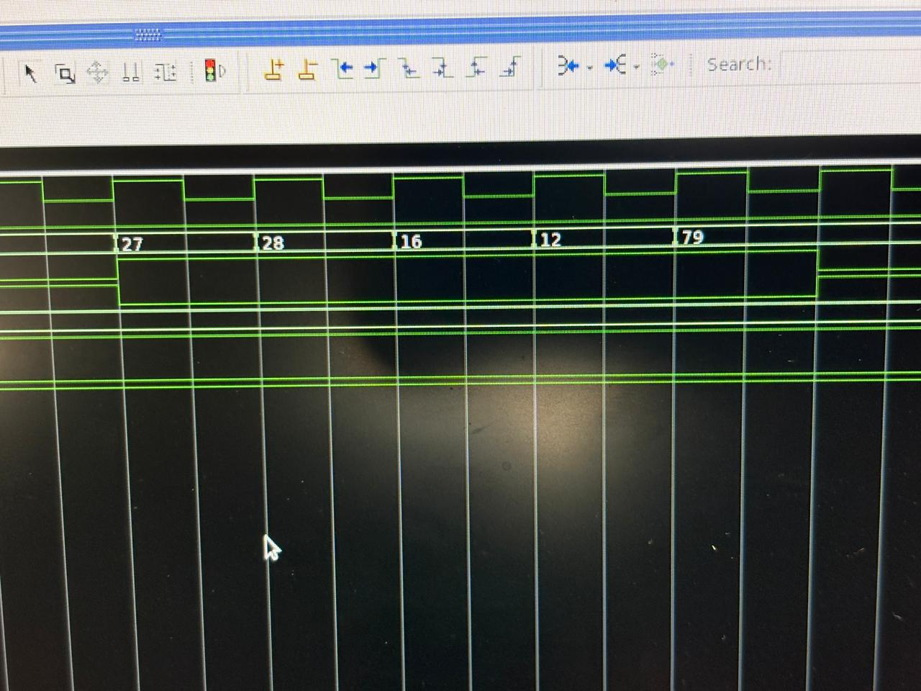
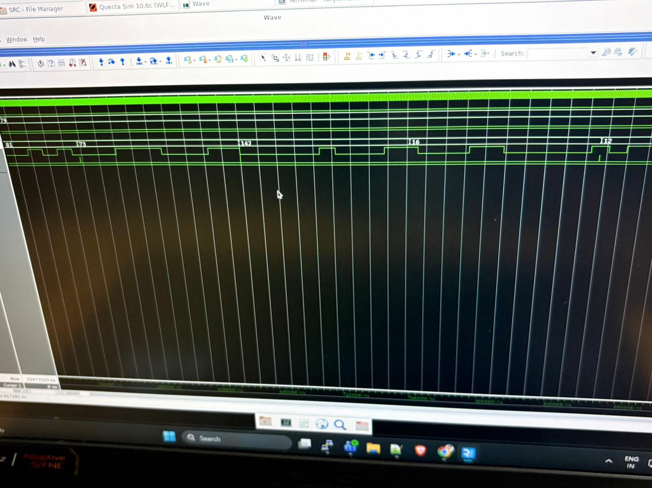
  Multi Stream of data – BUG4
    After receiving the first stream of data successfully we immediately sent the next stream of data in that case the first 2 byte if next stream were missing.

Slide 11
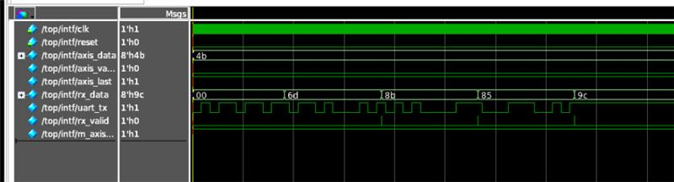
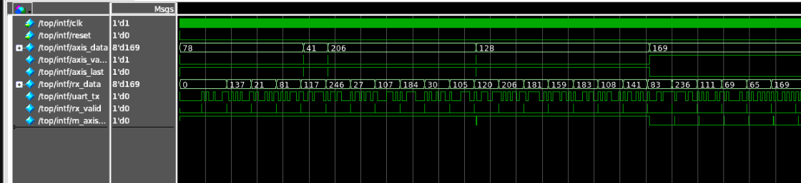
  RX_VALID triggering missed – BUG5
    While sending the stream of data we have observed that even when the parallel data and serial data are matching the RX valid signal is not triggered high for every first byte of data.
RX_VALID triggering for the data we didn’t send – BUG6 (Specification bug)

Slide 12
Sl.no | Bug | Description | Status | Type of BUG
1 | Missing of last packet | When N packets are sent,we receive only N-1 packets from DUT,where last data is missed. | Solved | DESIGN
2 | axis_last is not working | According to the specification,axis_last signal which needs to be asserted when the last packet of the stream is sent,but the last packet is not coming out from DUT. | Specification changed | SPECIFICATION
3 | rx_valid is not asserted for first packet | rx_valid which is asserted when the parity of parallel data and serial data are matched,is not getting asserted for the first packet of the stream even when parity is matching | Solved | DESIGN
4 | Junk value from DUT | When multiple stream of packets are sent, if number of packets are greater than fifo size ,everything works fine,but when number of packets are less than fifo size the first stream comes out as expected , but in second stream first 2 packets are lost and instead of that a junk value comes from DUT and then rest 3 packets come out as expected. | Solved | DESIGN
5 | Rx_valid asserting without data | Even when we are sending our first data as 137 with axis_valid , the rx-valid is asserting high for data – 0 which is default in the start this condition has not been mentioned in the spec | Solved | SPECIFICATION
6 | Reset | When asserting the reset after some time the data which is present in the last and first was only coming | Solved | DESIGN
BUG LOG

Slide 13
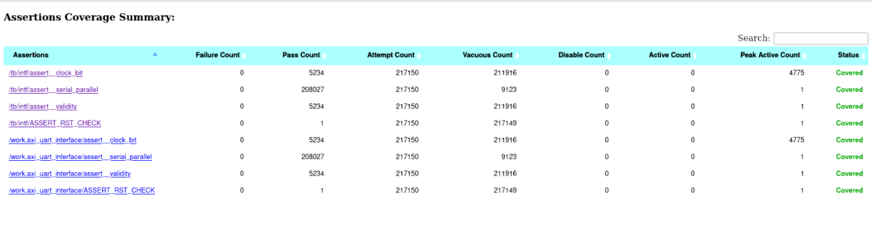
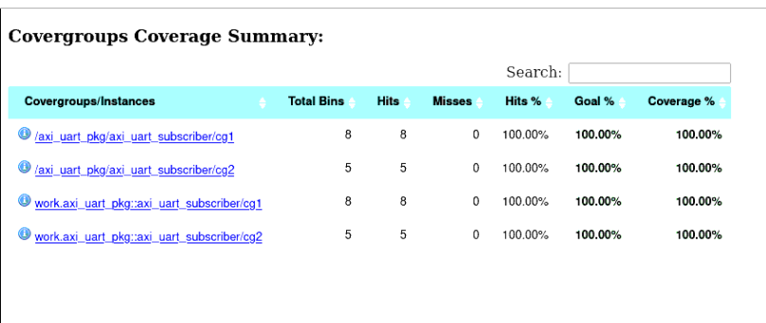
FUNCTIONAL COVERAGE

Slide 14



CODE COVERAGE WITHOUT EXCLUSION

Slide 15
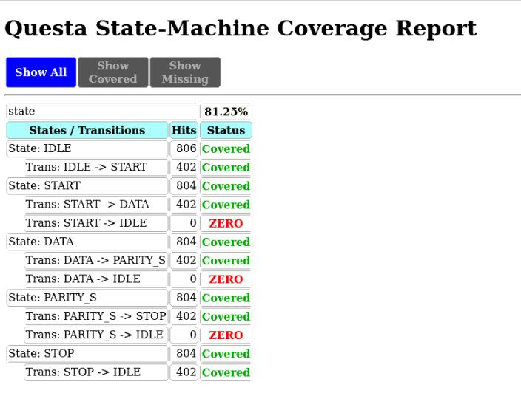
Reason of Less Code Coverage

Slide 16
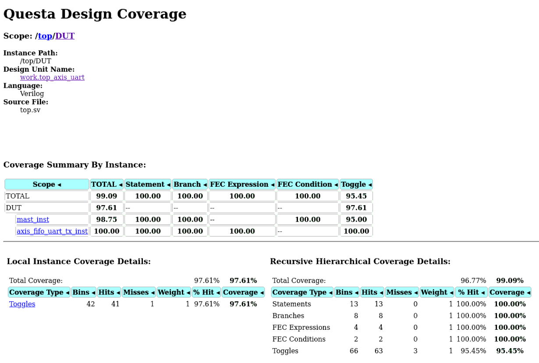
CODE COVERAGE AFTER EXCLUSION

Slide 17
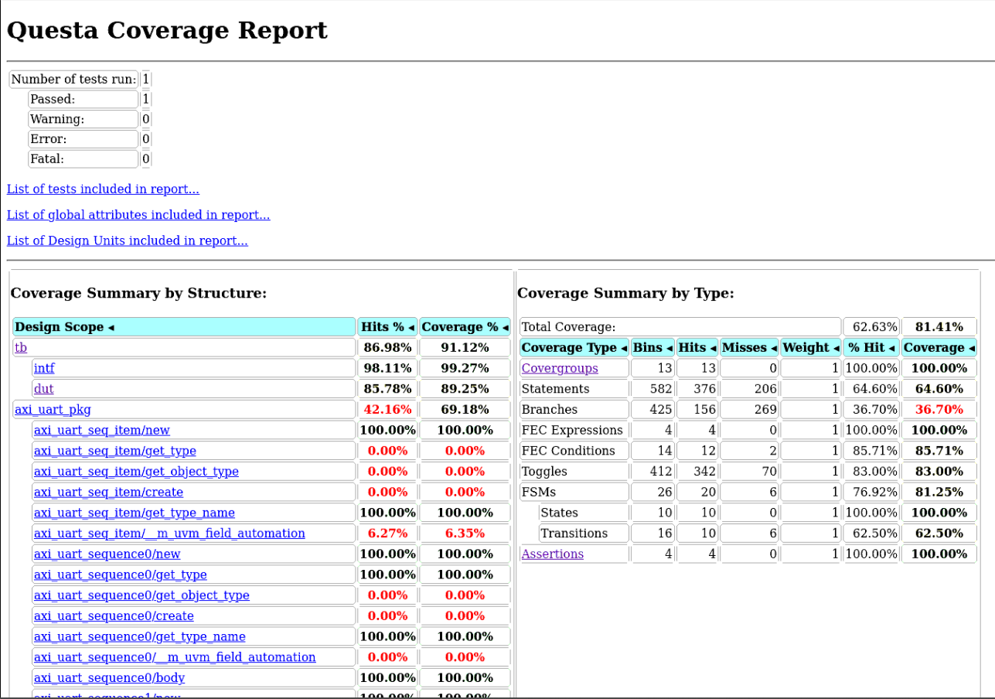
Overall Coverage

Slide 18
Assertions
Assertion | Description | Status
RESET | While reset is asserted all the ouputs should be 0 except m_axis_ready | PASS
VALIDITY | When valid is asserted high then all the output | PASS
OUTPUT _AFTER_4774 | When axis_data is present the rx_data should be present after 4774 clock cycles | PASS
Parallel_serial | When RX_DATA is high, the serial data should be present and RX_VALID SHOULD BE HIGH | PASS

Slide 19
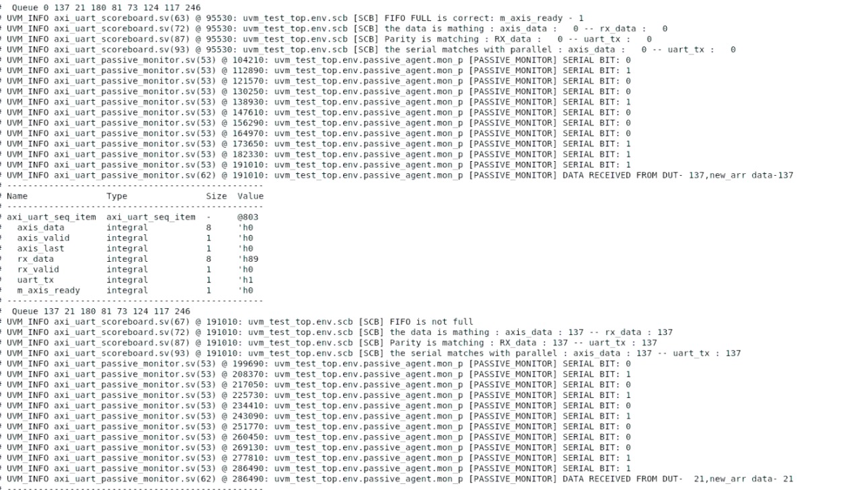
OUTPUT

Slide 20
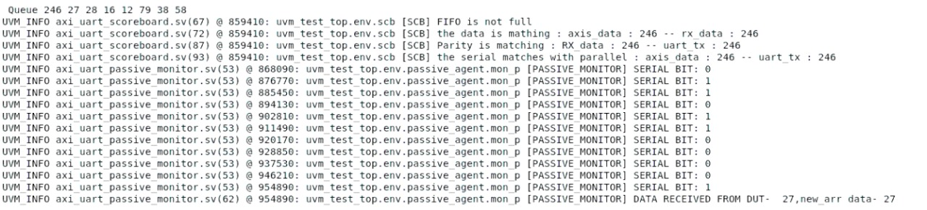
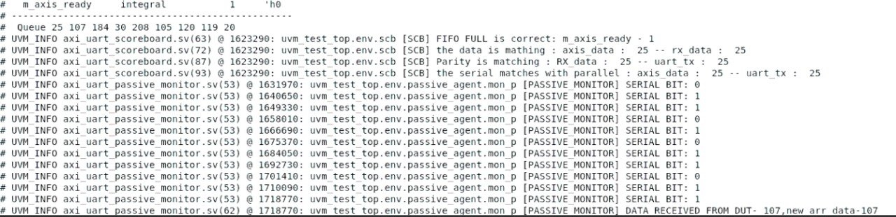

Slide 21
